Slide 1
Network Security It Just Makes pfSense
Kyle Goode
https://github.com/kgoode517/pfSense

Slide 2
What is pfSense?
Pfsense is an extremely powerful firewall, load balancer, vpn,IDS/IPS, SSL Inspector, and Router.
Started as a fork of the mon0wall project back in 2004
Freebsd Unix based
Got it’s name for making firewall packet filtering easy to use and understand
Is open source with paid support options

Slide 3
Why Use pfSense?
To learn how enterprise security services work such as ssl inspection, IDS/IPS, and VPN tunneling.
To save significant cost on big name brand solutions
To have granular control over your network security

Slide 4
How do I get pfSense?
Diy hardware, virtual machine or cloud(AWS,Azure).
Offical Netgate hardware
Community edition or plus(Tac lite used to be free $129 now)

Slide 5

Suricata
Inline IPS
Proofpoint Emerging Threat
Snort and Snort Subscriber
Feodo Tracker C2 botnets
ABUSE.ch ssl Blacklist
Auto Updates via Cron Jobs
3CORESec/testmynids.org

Slide 6
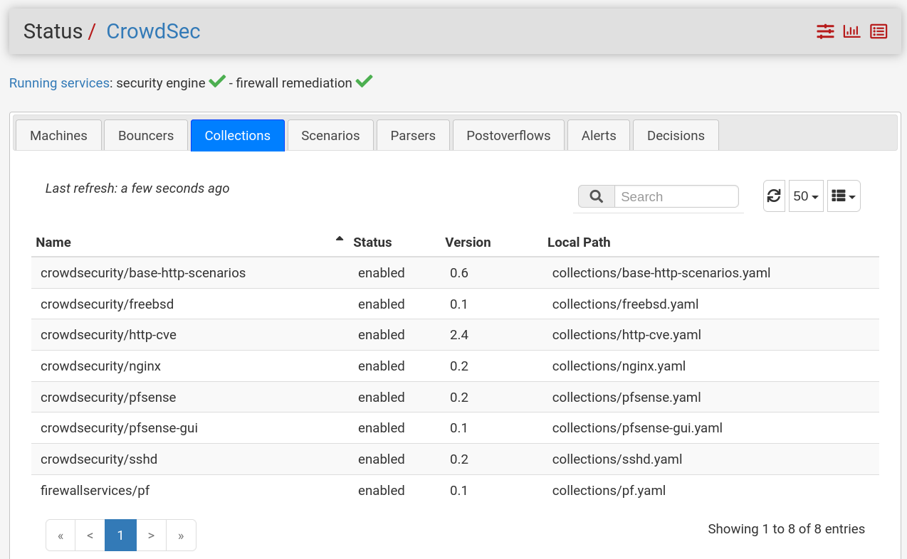
CrowdSec
Crowd Sourced Security Intelligence
Curated Network Wide Block Lists
Can detect threats to the firewall itself such as port scanning
Fully autonomous security engine

Slide 7
pfBlockerNG
So many threat feeds such as Spamhaus,Phishtank,and Alienvault
Spans across sub categories such as cryptojackers, phishing, and Tor
200+ feeds
Cron Job Updates

Slide 8

The ClamAVity of Squid
01
02
An ethical hacker points out the vulnerabilities in Squid
Netgate publicly disowns squid
A time line
03
04
05
Netgate does not respond
The pfSense community updates Squid themselves
Squid fixes its vulnerabilities

Slide 9

Haproxy
Stands for High Availability Proxy
Excellent Application Load Balancer
Offers features such as health checks, rate limiting, and ssl offloading
Compatible with CA’s such as Let’s Encrypt

Slide 10
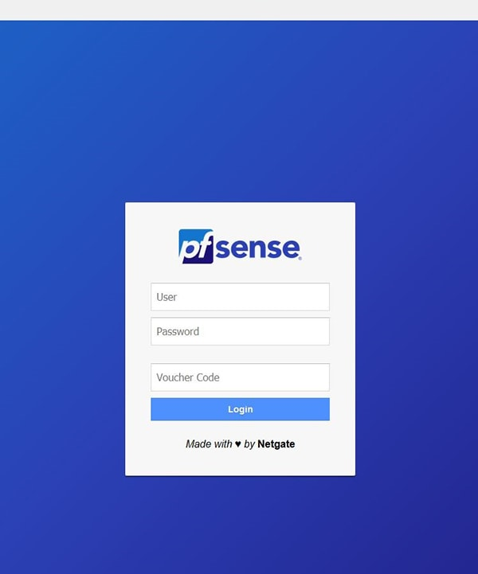
Captive Audience Meet Captive Portals
Access Management
User Authentication
Network Usage Visibility

Slide 11
SIEM Ingestion
Syslog it goes with everything
Security Onion
Wazuh
Blumira

Slide 12
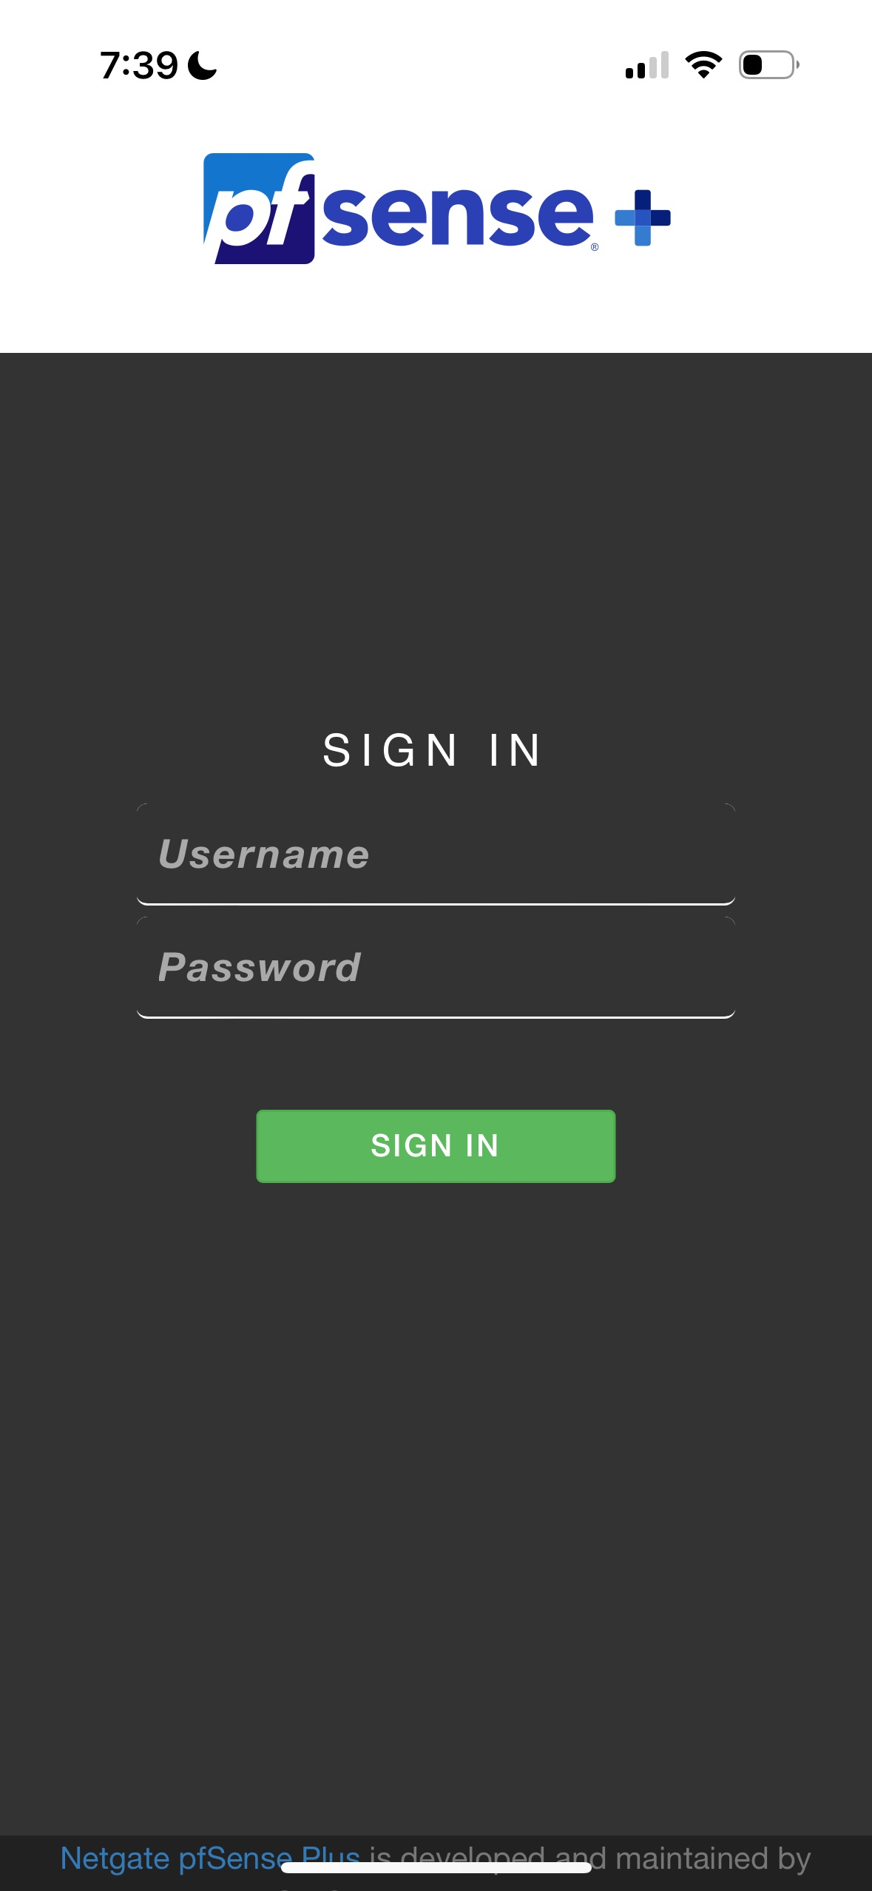
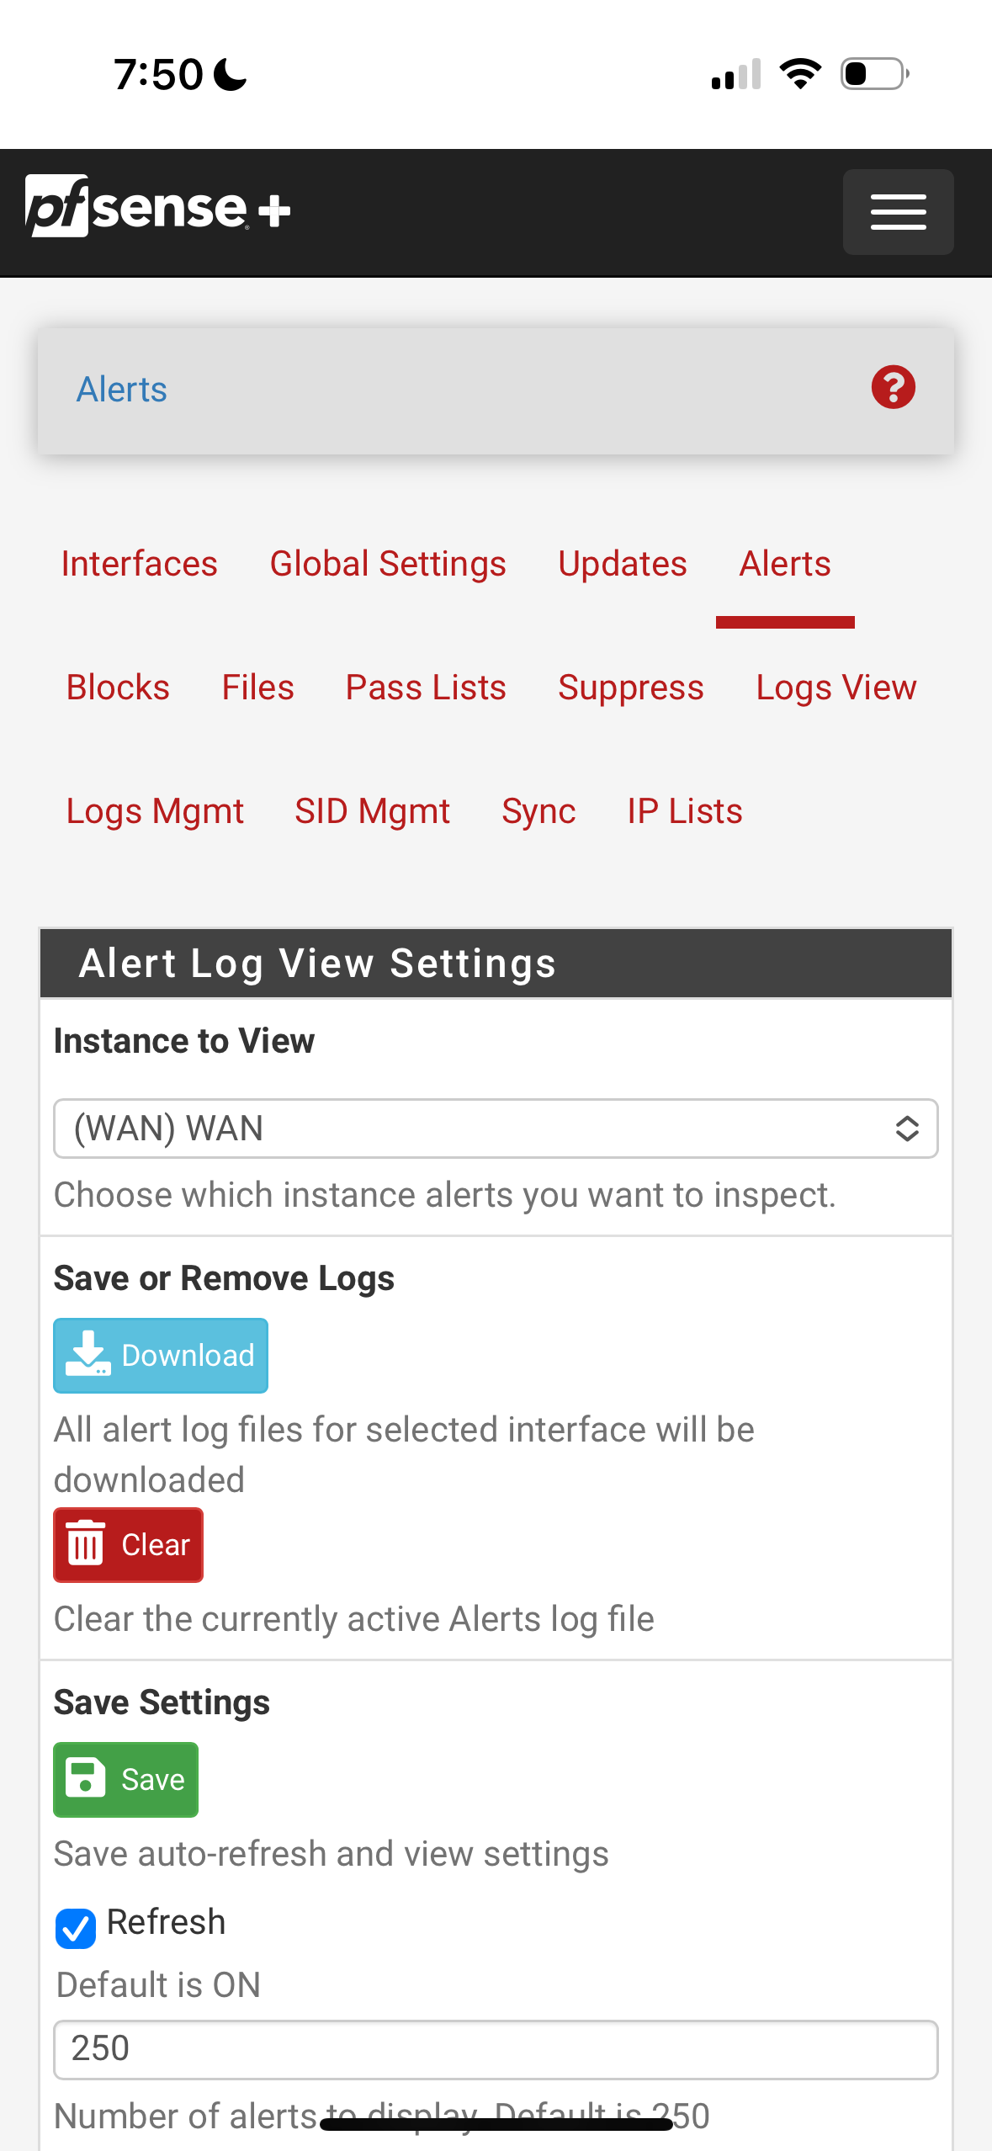
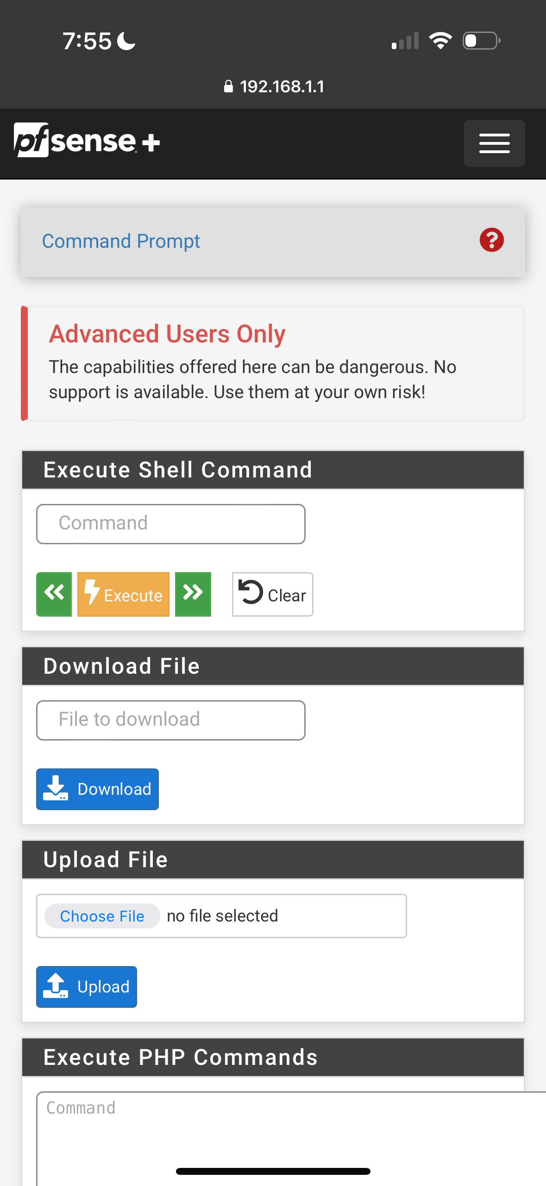
App Smap
Mobile Webpage works great

Slide 13
Kernel Panic?
Netgate announces migrating from Freebsd to a Linux Kernel
April Fools Joke or Not?
Potential implications of additional security packages such as Osquery, Tailscale, and Elastic Agent.

Slide 14
Resources to get started
Network chuck
LawrenceSystems
Netgate pfSense docs
AI your friend
r/pfSense
Netgate forum

Slide 15
Another Mystery Solved Scoob!
LinkedIn

